Slide 1
MULTI-REGIONAL PURCHASING COOPERATIVE
Instructions for Campus Users

Slide 2
NEEDS LIST INSTRUCTIONS

Slide 3
MRPC NEEDS LIST
The Multi-Regional Purchasing Cooperative Line Item Bid is designed to give schools more power in purchasing their basic supply needs such as classroom/office furniture and electronics; and office, classroom, janitorial and nursing supplies. By combining the amounts needed by the participating schools across four regions (Regions 9, 11, 14 and 15), better pricing can be obtained from vendors.
The Needs List is the basis of the Line Item Bid. It tells vendors the quantity of each product that will be ordered. The vendors take this number to their suppliers/manufacturers to obtain volume discount and pass the savings on to us.
Because the bid pricing is based on the number we give them through the Needs List, it is VERY IMPORTANT that the number you enter at this point is as accurate as possible. The bid specifies that the quantity we give is within 10% of the final order.
In our new program, your Needs List will also become the basis of your final purchase order, so being accurate now will save you time later.

Slide 4
Open MRPC folder found on Drive R: on your district’s network server.
Go to “My Computer”
Select Drive R
Click on “MRPC” folder
If you do not have Access 2007 program, you will need to click on the “AccessRuntime” program and follow the instructions to run this program.

Slide 5
Click on MRPC District Program

Slide 6
When the program opens, you may see a “Security Warning” underneath the ribbon.
Click on the “Options” button following the warning, then select “Enable Content”.

Slide 7
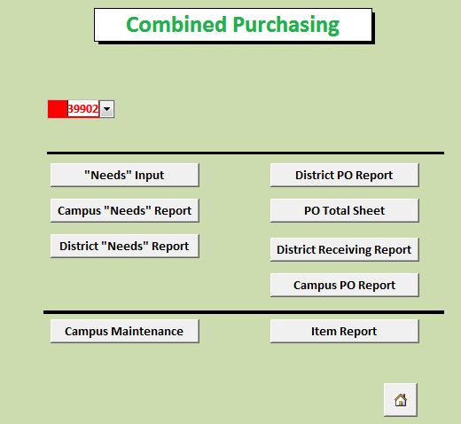
Select your district from red drop down menu.
Click on “Needs” Input

Slide 8
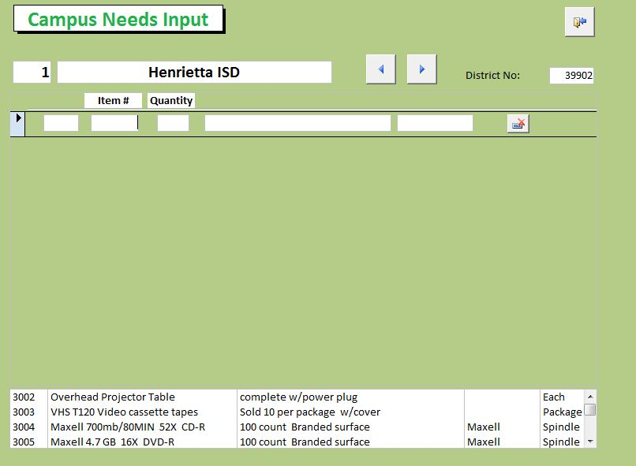
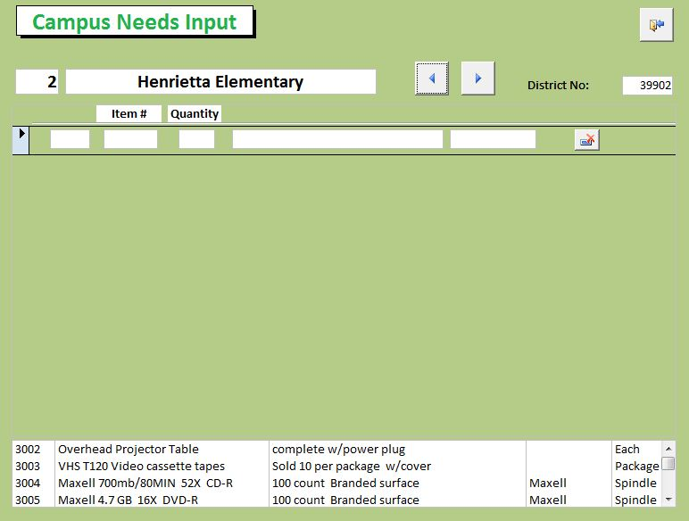
Select your campus by using the arrows to scroll through the list

Slide 9
Note table at bottom of screen. This is the listing of items on the needs list. You can minimize the ribbon at the top of the screen or change your screen resolution to increase the size of the table.

Slide 10
To minimize the ribbon, right click on top blue strip.
Click on “minimize the ribbon” which will make tool bar disappear. (To bring back right click on ribbon and “un-click” the “minimize the ribbon” option.)
With Ribbon Showing
No Ribbon

Slide 11
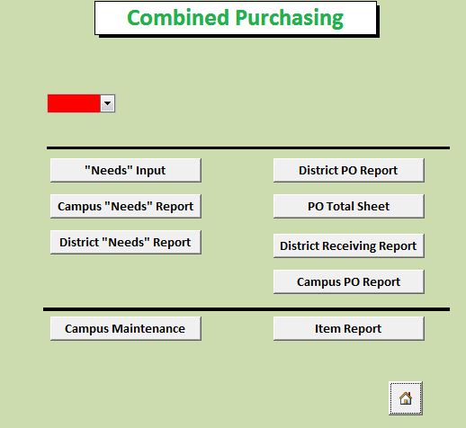
You can also see or print a complete needs list, by clicking on “Item Report” on the main screen.

Slide 12
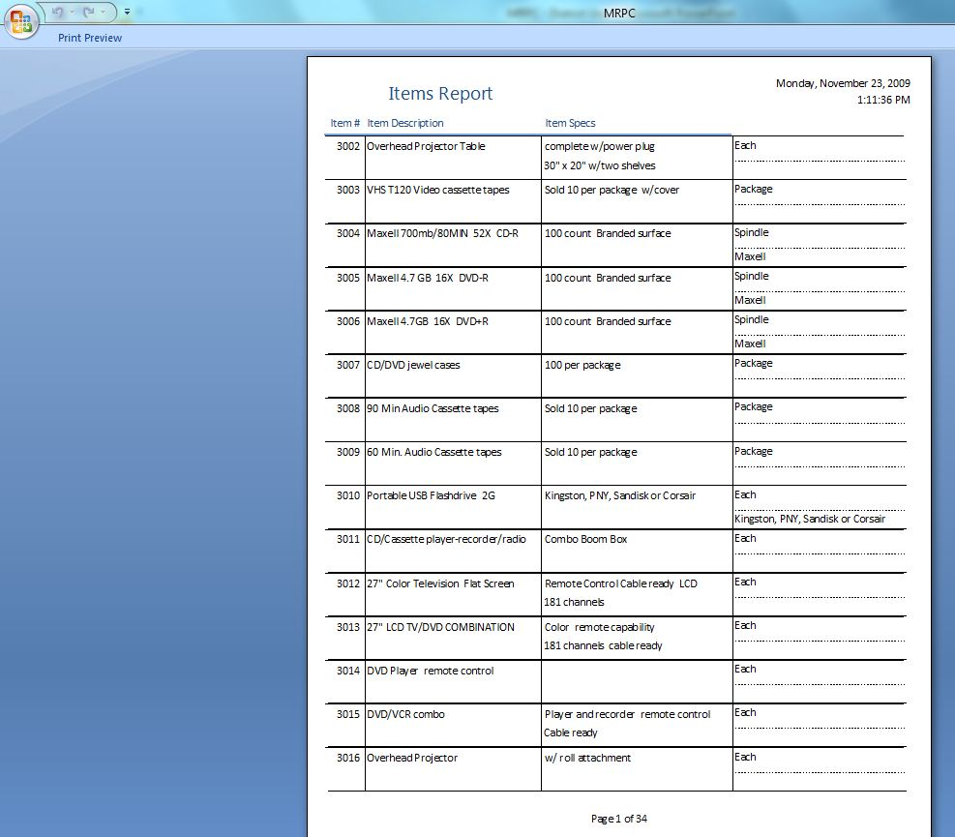
Item Report Listing

Slide 13
To enter needs, click on Item # field, type in item number to be ordered.

Slide 14
Tab to quantity field. Note that when you hit the tab key, the item description fills in automatically. Review to make sure this is the correct item.

Slide 15
Type in desired quantity.
Push tab to go to next record; key in item number and quantity. Continue process until all desired items are entered.
Delete Record
NOTE: If you key in an item you decide you do not want, simply hit the “Delete Record” key at the end of the record. A warning message will appear asking if you really want to delete that record; hit yes or no as desired.

Slide 16
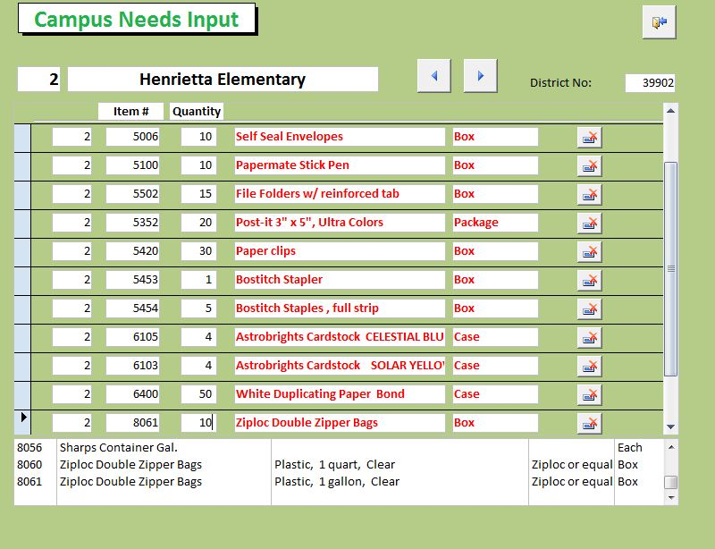
Once all needs have been entered, hit “exit” icon.

Slide 17
Click on Campus “Needs” Report to generate and review a complete report of your order.

Slide 18
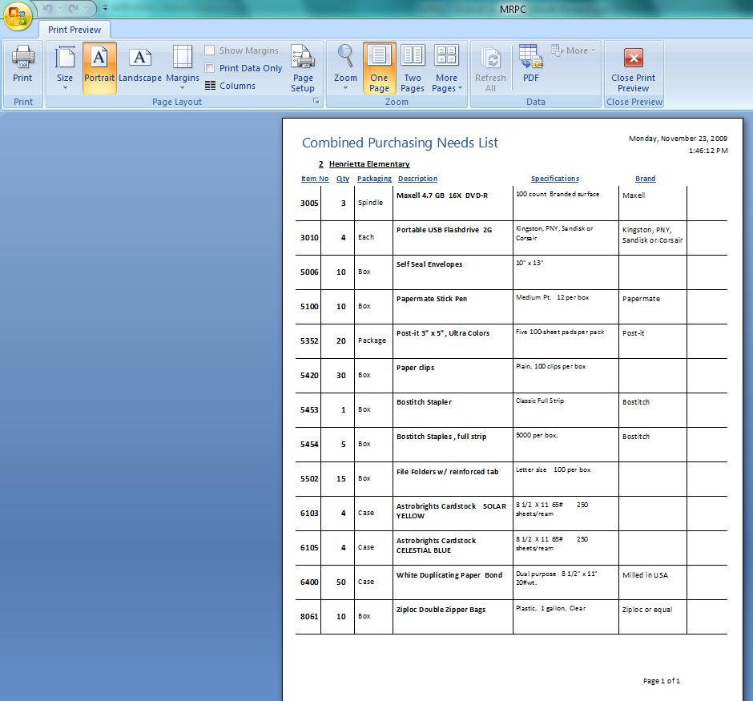
Review your list; you may print for your records if desired. (You may need to maximize the ribbon to get tool bar back for printing.)

Slide 19
When you are satisfied that all needs for your campus (or department) have been entered correctly, close the program by clicking on the house icon.
Close Program

Slide 20
Let your district contact know your needs list has been completed, and you are done until purchasing time next spring!
Have a coffee break!

